Slide 1

Databases
Data Mining
Data Products
Notes:
https://www.youtube.com/watch?v=ps6HweFb5LI big data
https://www.youtube.com/watch?v=8pHzROP1D-w min 7.29 big data
https://www.youtube.com/watch?v=mhe5kX10CR4
https://www.youtube.com/watch?v=TzxmjbL-i4Y
https://www.youtube.com/watch?v=QSIPNhOiMoE IOT

Slide 2
Database and Data Warehouse
A database is a software application that stores records and attributes
A data warehouse is a database that collects a firm’s transactional and customer data in a single location for offline

Slide 3
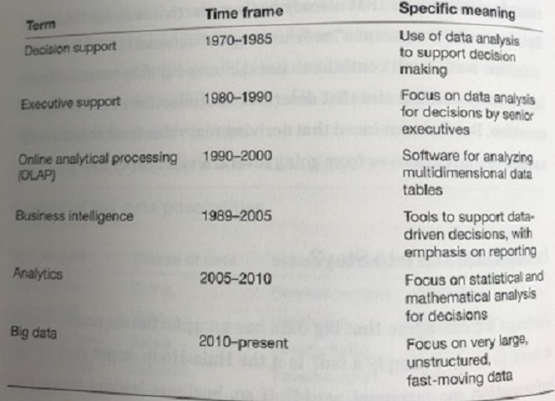
Terminology for Using and Analysing Data

Slide 4
Context
Context defines the value of data: information without context is worthless, while information with context is essential for delivering personalized experiences, whether for leisure or work.

Slide 5
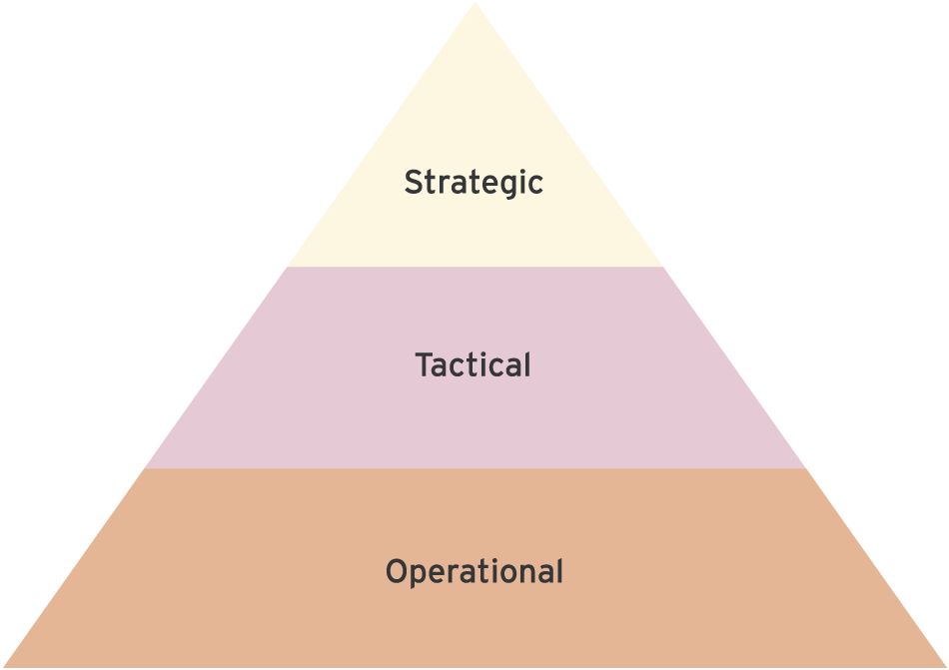
Figure 1.3 Levels of managerial decision taking

Slide 6
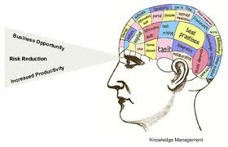
Knowledge Management
Notes:
What is Knowledge Management? "Knowledge Management caters to the critical issues of organizational adaptation, survival, and competence in face of increasingly discontinuous environmental change.... Essentially, it embodies organizational processes that seek synergistic combination of data and information processing capacity of information technologies, and the creative and innovative capacity of human beings." more...
Clearly the goal of knowledge management is sustained individual and business performance through ongoing learning, unlearning, and adaptation. Technologies of computing have inherent limitations. They have difficulty in generating meaningful insights from data as they can’t question or re-interpret their programmed logic and assumptions. Given inherent limitations of the technologies of computing, human users of such 'systems' have at least an equally important role in knowledge management. more...
Lessons learned from the world's greatest organizations show that even simple technologies can generate great performance when empowered by smart minds of motivated and committed humans. Conversely, 'intelligent' technologies may produce dumb results if those smarts are missing as evident from the cases of companies once considered great in the past era. Importantly, unless data and information are translated into 'meaningful' decisions and actions for sustained performance, there is no point of the whole exercise... whether you call it knowledge management, wisdom management, creativity management, or something else! more...
Our following summary interpretations of the above 'working definition' of Knowledge Management are also popular among corporate strategists and military, airforce, and navy commanders. KM is: 'Knowing what you know and profit from it' and 'Making obsolete what you know before others obsolete it Source:http://www.brint.com/km/

Slide 7
Knowledge Management
The European Guide to Best Practice in Knowledge Management defines knowledge as:
‘The combination of data and information to which is added expert opinion, skills and experience to result in a valuable asset which can be used to make decisions. It is the essential factor in adding meaning to information. Knowledge may be explicit and/or tacit, individual and/or collective’ Mekhilef et al., 2003
Notes:
What is Knowledge Management? "Knowledge Management caters to the critical issues of organizational adaptation, survival, and competence in face of increasingly discontinuous environmental change.... Essentially, it embodies organizational processes that seek synergistic combination of data and information processing capacity of information technologies, and the creative and innovative capacity of human beings." more...
Clearly the goal of knowledge management is sustained individual and business performance through ongoing learning, unlearning, and adaptation. Technologies of computing have inherent limitations. They have difficulty in generating meaningful insights from data as they can’t question or re-interpret their programmed logic and assumptions. Given inherent limitations of the technologies of computing, human users of such 'systems' have at least an equally important role in knowledge management. more...
Lessons learned from the world's greatest organizations show that even simple technologies can generate great performance when empowered by smart minds of motivated and committed humans. Conversely, 'intelligent' technologies may produce dumb results if those smarts are missing as evident from the cases of companies once considered great in the past era. Importantly, unless data and information are translated into 'meaningful' decisions and actions for sustained performance, there is no point of the whole exercise... whether you call it knowledge management, wisdom management, creativity management, or something else! more...
Our following summary interpretations of the above 'working definition' of Knowledge Management are also popular among corporate strategists and military, airforce, and navy commanders. KM is: 'Knowing what you know and profit from it' and 'Making obsolete what you know before others obsolete it Source:http://www.brint.com/km/

Slide 8
MANAGERIAL ISSUES
Every day knowledge essential to your business walks out of your door, and much of it never comes back
Customers come and go and their knowledge leaves with them.
The information drain costs you time money and customers.

Slide 9

Explicit Knowledge
Details of process & Procedures
E.g., Records of meetings between sales rep and key customer
Procedures for dealing with customer queries

Slide 10
Knowledge – Explicit knowledge
Explicit knowledge has been codified (documented) in a form that can be distributed to others or transformed into a process or strategy without requiring interpersonal interaction.
Data
Policies
Procedures
Software
Documents
Products
Strategies
Goals
Mission
Core competencies

Slide 11
Tacit Knowledge
Tacit knowledge is usually in the domain of subjective, cognitive, and experiential learning; it is highly personal and difficult to formalize.

Slide 12
Knowledge – Tacit knowledge
Tacit knowledge is the cumulative store
of the corporate experiences
Mental maps
Insights
Acumen
Expertise
Know-how
Trade secrets
Skill sets
Learning of an organization
The organizational culture

Slide 13
“Data should be the vital raw material that strengthens and improves the machinery of decision making.
Source: “Data-ism,” Steve Lohr (2015)

Slide 14
“Data should be the vital raw material that strengthens and improves the machinery of decision making.
Data is the input, and the output is smarter choices and wiser judgments. But the data paradox is that a world richer and richer in data has so far yielded little payoff in most fields.
Source: “Data-ism,” Steve Lohr (2015)

Slide 15
“Data should be the vital raw material that strengthens and improves the machinery of decision making.
Data is the input, and the output is smarter choices and wiser judgments. But the data paradox is that a world richer and richer in data has so far yielded little payoff in most fields.
The supply of data races ahead, while the ability to use it lags badly.”
Source: “Data-ism,” Steve Lohr (2015)

Slide 16
“Time after time it happens that some ignorant or presumptuous member of a committee or a board of directors will upset the carefully-thought-out plan of a man who knows the facts, simply because the man with the facts cannot present his facts readily enough to overcome the opposition.”
Willard Brinton began his landmark book “Graphic Methods for Presenting Facts” 1914

Slide 17
Data privacy and privacy policies
Data privacy and privacy policies, which are the backbone of understanding data rights.

Slide 18
Fines for Meta
Meta (Jan 2023) fined by the Irish Data Protection Commission more than $400 million ---the company’s advertising and data handling practices were in breach of EU privacy laws.
Two Fines
210 million euro fine for violations of EU GDPR - Facebook
180 million euro fine related to breaches of the EU GDPR by Instagram

Slide 19

Data Mining
Notes:
19
Data mining can begin at a summary information level (coarse granularity) and progress through increasing levels of detail (drilling down), or the reverse (drilling up)
Data-mining tools include query tools, reporting tools, multidimensional analysis tools, statistical tools, and intelligent agents
Q: Provide an example of what an accountant might discover through the use of data-mining tools
Ans: An accountant could drill down into the details of all of the expense and revenue finding great business intelligence including which employees are spending the most amount of money on long-distance phone calls to which customers are returning the most products
Could the data warehousing team at Enron have discovered the accounting inaccuracies that caused the company to go bankrupt?

Slide 20
Multidimensional Analysis and Data Mining
Data mining – the process of analyzing data to extract information not offered by the raw data alone
To perform data mining users need data-mining tools
Data-mining tool – uses a variety of techniques to find patterns and relationships in large volumes of information and infers rules that predict future behavior and guide decision making
Notes:
20
Data mining can begin at a summary information level (coarse granularity) and progress through increasing levels of detail (drilling down), or the reverse (drilling up)
Data-mining tools include query tools, reporting tools, multidimensional analysis tools, statistical tools, and intelligent agents
Q: Provide an example of what an accountant might discover through the use of data-mining tools
Ans: An accountant could drill down into the details of all of the expense and revenue finding great business intelligence including which employees are spending the most amount of money on long-distance phone calls to which customers are returning the most products
Could the data warehousing team at Enron have discovered the accounting inaccuracies that caused the company to go bankrupt?

Slide 21

Data Mining
In Summary, A Business Intelligence Tool
Discovers previously unknown patterns within vast amounts of data
Similar to querying a database (or databases)
Instead of gathering raw data, data mining retrieves “information”
Types of Data Mining…
Hypothesis Testing
Undirected Data Mining
Directed Data Mining

Slide 22
Data Mining
Hypothesis Testing
Answers Questions
Example…
Q: Does the age of an insurance agent matter when trying
to sign-up new customers to new policies?
A: The assumption might have been that older, more experienced agents will have more success. But,the data may reveal that the age difference between the agent and the policy holder is most important. (Young agents have more success with young customers while older agents have success with older customers.)

Slide 23
Data Mining
Undirected Data Mining
Letting algorithms find “patterns” in vast amounts of data
Types…
Automatic Cluster Detection
Market Basket Analysis
Sequential Pattern Matching
Finds “clumps” of customers
who are similar because of
income level, buying habits,
geographic location, etc.

Slide 24
Data Mining
Undirected Data Mining
Letting algorithms find “patterns” in vast amounts of data
Types…
Automatic Cluster Detection
Market Basket Analysis
Sequential Pattern Matching
Determines what types of
products (and services)
are purchased at the same
point in time

Slide 25
Data Mining
Undirected Data Mining
Letting algorithms find “patterns” in vast amounts of data
Types…
Automatic Cluster Detection
Market Basket Analysis
Sequential Pattern Matching
Determines events that
occur in a particular
sequence in time

Slide 26

Data Mining
Directed Data Mining
Known as “Predictive” or “Profiling” Data Mining
Applying data from the past to a similar business situation in the future
Customer Churn Example…
A customer that has left in the past is similar to one who will leave
in the future. So, gather data on lost customers in order to hopefully
decrease the likelihood that current customers will leave.
Marketing Example…
Customers who responded to an advertisement or purchased a
product in the past are similar to those who will buy in the future.

Slide 27

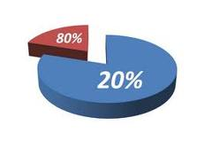
VIP Customers
“VIP Customers”…Identify customers who are power buyers
The top 20% of your customers account for 80% of total sales
Retailers must constantly communicate with these customers to promote new products
“Inventory Advantage”…Retailer orders are placed 6 months prior to a shopping season. They first contact VIP customers to buy new products (at a discount) then adjust inventory levels based on their response

Slide 28
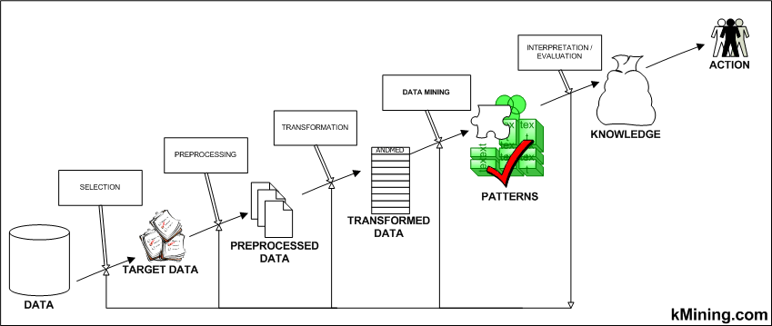
As computer scientists continue to refine data-mining algorithms, they are uncovering new ways to predict how people will react when they are presented with information
They are learning not only how to identify us but also how to manipulate us

